Slide 1
Market Segmenting the Modern Gamer
An Exploratory Analysis on the Console Gaming Market

Slide 2
Contents
Business Problem
Segmentation Process
Variables of Interest
Factor Analysis
Cluster Analysis
Comparing the Means
The Clusters
Final Thoughts

Slide 3
Business Problem
The year is 2012, and advancements in electronics and hand held devices are changing the way individuals spend their free time. The nature of video games is changing; smart phones are taking video games out of the homes and into everyone’s hands and consoles like the Nintendo Wii and WiiU are inciting the production of games that are mobile, user friendly, and appeal to a wider range of audiences.

Slide 4
Business Problem
With the Nintendo Wii U set to launch at the end of 2012 and next generation consoles the Playstation 4 and Xbox One set to launch in the Fall of 2013, game developers are wondering if the consumer market for console gaming is changing with the times. What does the new generation of console gamers look like and which systems do they play?

Slide 5
Segmentation Process
Define the Business Problem
Collect, Examine, Clean variables of interest
Factor Analysis
Cluster Analysis

Slide 6
The Variables

Slide 7
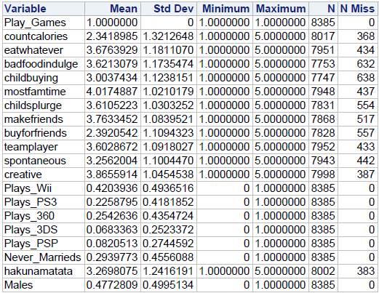
Variables of Interest
As the objective is to get an idea of what the modern console gamer looks like, our target population is U.S. Adult CONSOLE GAMERS age 18 or older. This study has a total of 8385 such individuals.

Slide 8
Variables of Interest – Factor Variables
Our factors of interest relate to food consciousness and family as we are trying to see how aspects contribute to the characteristics of the modern gamer.
Food related factor variables are:
countcalories: “I normally count the calories of the foods I eat.”
eatwhatever: “I eat the foods I like regardless of calories.”
badfoodindulge: “There is nothing wrong with indulging in eating fattening foods from time to time.”

Slide 9
Variables of Interest – Factor Variables
Family related factor variables are:
childbuying: “My children have a significant impact on the brands I choose.”
mostfamtime: “I like spending most of my time at home with my family.”
childsplurge: “I often indulge my children with little extras.”

Slide 10
Variables of Interest – Cluster Variables
The Cluster variables were used to from and segment the clusters after the factors had been created.
Console related cluster variables are:
Plays_Wii: The respondent owns/plays the Nintendo Wii
Plays_PS3: The respondent owns/plays the Playstation 3
Plays_360: The respondent owns/plays the Xbox 360
Other cluster variables include:
hakunamatata: “I like to enjoy life and do not worry about the future.”
males: the respondent is male
spontaneous: “I often do things on the spur of the moment.”

Slide 11
Variables of Interest – Non - Drivers
Non-driver variables were used to further segment the clusters.
Non-driver variables include:
Plays_3DS: The respondent owns/plays the Nintendo 3DS
Plays_PSP: The respondent owns/plays the Playstation PSP
makefriends: “I make friends easily.”
buyforfriends: “I prefer to buy things that my friends and neighbors would approve of.”
teamplayer: “I prefer to work as part of a team rather than alone.”
nevermarrieds: The respondent has never been married
Creative : “I consider myself to be a creative person.”

Slide 12
Factor Analysis

Slide 13
Factor Analysis – The Variables
As our business objective is to determine what the modern console gamer looks like (i.e. unhealthy and introverted)I collected questions that measure constructs related to food and family.
All variables are rated on 5-Point scale ranging from 5 = “Strongly Agree” to 1 = “Strongly Disagree”.

Slide 14
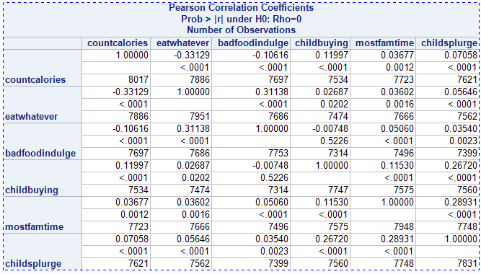
Factor Analysis - Correlations
Factor Analysis can be a trivial procedure if the variables involved are not at least somewhat correlated. I first ran correlations among all the variables to ensure that they were at least somewhat correlated.
The results weren’t too impressive, however several of the variables showed some correlation which implied that factor analysis would provide useful results.

Slide 15
Factor Analysis - Procedure
To create the factors we utilized the process of factor analysis rather than principal component analysis as the former assumes that the variables that the analysis is run on are measuring some latent/abstract construct, while the latter makes no such assumption.
After the features are extracted a rotation method must be implemented to make the results more interpretable. For this we used varimax rotation (an orthogonal rotation) which preserves the independence of the factors ensuring that they are as unique as possible.

Slide 16
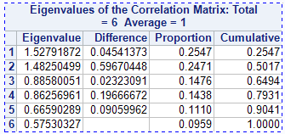
Factor Analysis - Results
The results of the factor analysis indicated that only two factors were necessary to capture data and variance present in the variables that were measured. A combination of 4 criteria were used to determine the number of factors to retain.
Kaiser Criterion: All factors with an Eigenvalue greater than 1 are retained.
Scree Test: Examining a scree plot (next slide), factors that occur before the “break” between components with relatively large and small eigenvalues are retained.
Proportion of Variance: Retain any factor whose individual proportion is greater than say…..20%
Cumulative Variance: Retain the factors that account for 70% of the cumulative variance.

Slide 17
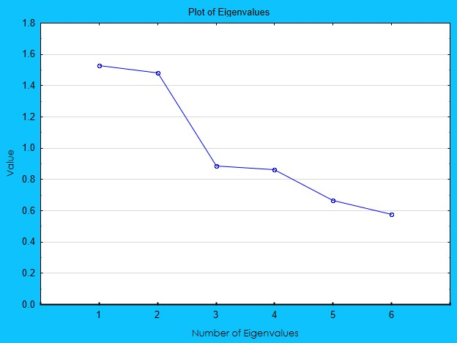
Factor Analysis - Results
Factors with an eigenvalue greater than 1 are retained because they capture AT LEAST as much variance as was contributed by any one variable.
The screeplot is a visual interpretation of the factors that shows which factors have relatively high and low eigenvalues.
Percentages for Proportion and Cumulative variance are used to ensure that the variables and factors measured are explaining a significant amount of variance. However these measures are subjective and should be used in conjunction with the other criteria.
Using a combination of these 4 criteria and the underlying knowledge that the original intent was in fact to measure two latent constructs, only two factors were retained for analysis. These two factors alone explained 50.17% of the variance in the data.

Slide 18
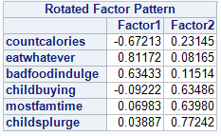
Factor Analysis - Results
Factor 1 is our “Indulgent Eaters” factor:
These individuals had very heavy loadings (either positive or negative) for all the food related questions in Factor 1 and low loadings in Factor 2.
These folks do not often count calories when they eat, they eat whatever they want regardless of the calories, and they do not feel it is bad to indulge in fattening foods.
Factor 2 is our “Family Matters” factor:
These individuals had very heavy loadings for all the family related questions in Factor 2 and low loadings in Factor 1.
These folks buying habits are heavily influenced by their children, they spend most of their time at home with their family, and they tend to indulge their children in little extras from time to time.

Slide 19
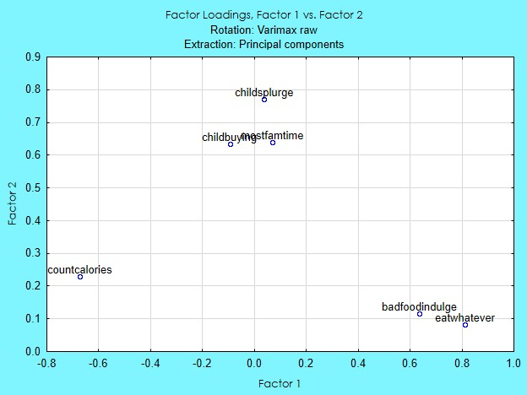
Factor Analysis - Results
The biplot also gives a nice visual of how each variable loads on the factors. Notice that all the food variables have high absolute values for Factor 1 and low absolute values for Factor 2, while the family variables have high absolute values for Factor 2 and almost zero in value for Factor 1.

Slide 20
Cluster Analysis

Slide 21
Cluster Analysis – The Variables
In addition to the factors that were extracted, several other variables were used to form the clusters. These variables regarded the gaming consoles themselves to infer which clusters used which systems the most. A few other demographic and psychographic variables were also used to help define the clusters.
For questions not on a 5-Point scale the respondent marked either 1=“Yes” or 0=“No”.

Slide 22
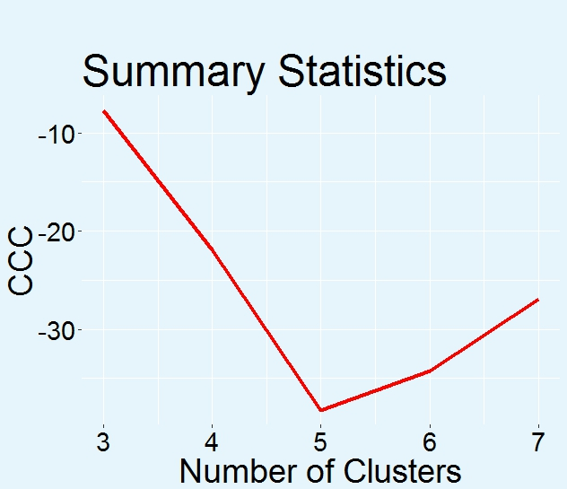
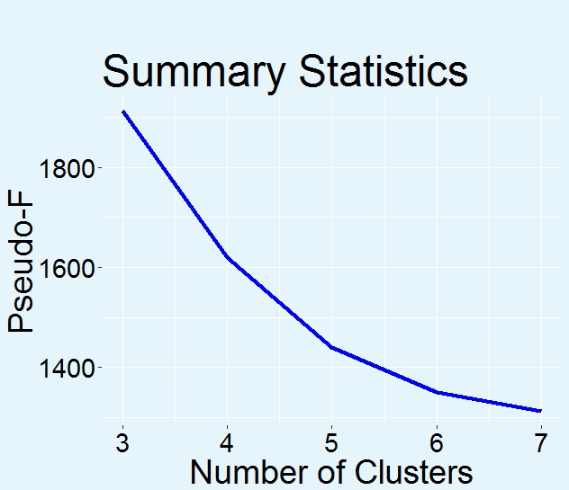
Cluster Analysis – Cluster Diagnostic Stats
The process I used for clustering (K-Means) allows the user to specify in advance how many clusters the analysis will produce. As deciding the optimal number of clusters to use is more of an art than a science there’s a couple of handy statistics we can rely on to determine the best number of clusters to use – the CCC and Pseudo F statistics.
I plotted the number of clusters against each of these statistics and the optimal number of clusters will have the highest CCC and Pseudo F statistics.
The plots indicate that choosing 5 clusters yields the highest CCC, but also the lowest Pseudo F, and choosing 3 clusters yields the lowest CCC but the highest Pseudo F.
Kind of frustrating really, but I think 4 clusters might be a decent compromise.

Slide 23
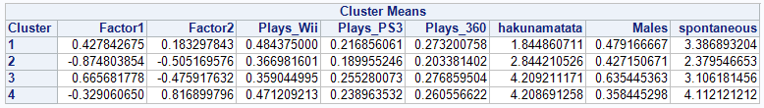

Cluster Analysis - Results
The means for each cluster are displayed below. Examining each mean by cluster, it’s clear that the means are spread quite well among the clusters. The values are not too close together as to cause the clusters to kind of “mush” together, and one can tell that there are some distinct differences between the clusters. Also, our overall population was quite evenly distributed (as shown in the frequency) and no one cluster seems to “own” all of the respondents. What is somewhat concerning is that the ranges of the individual consoles themselves are a bit small, however, when looking at them as a whole it’s clear that the Nintendo Wii tends to weigh much more heavily in a couple of the clusters than the other two consoles. This is exactly the kind of thing we were looking for!!!!

Slide 24
Comparing the means – the Non-Driver Variables
With the clusters performing well I collected a final set of variables (both demographic and psychographic) to see how they related to each of the clusters. I grabbed handheld gaming systems like the 3DS and PSP to see which clusters frequented the use of these devices and also a few other social psycho/demographics to get a better understanding of the characteristics of each cluster.

Slide 25
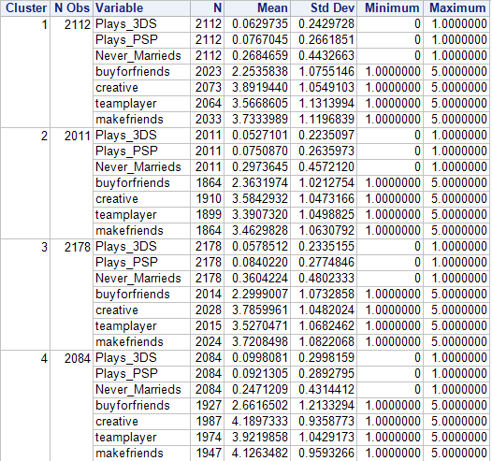
Comparing the means – the Non-Driver Variables
The table to the right shows the means for each non-driver and how they scored among each cluster. The means are quite well spread among the individual clusters, with the handheld gaming devices not being so well spread out again. There still are some distinct differences among the clusters however. Cluster 4 seems to have the least trouble making friends, while Cluster 2 appears to struggle the most in this area. It seems Cluster 3 has the most individuals that have never been married, while Cluster 4 has the least. Hmmmm……….

Slide 26
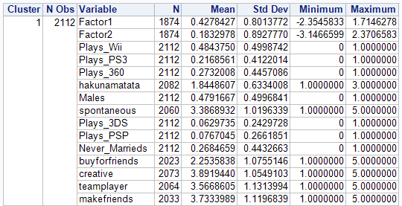

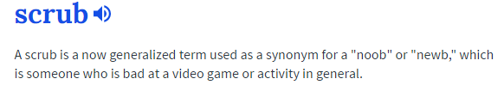
The Clusters – Cluster 1: The Hardcores
These individuals are avid gamers who consider gaming something serious and an exciting challenge. With one of the larger segments of males among the clusters, characterized by somewhat unhealthy eating choices and relatively low family, these scrub pwners scored the lowest in regards to being carefree and play on all the consoles in general. The Hardcores also scored lowest in regards to buying products that their friends would approve of indicating that they enjoy their craft and aren’t influenced by others when it comes to their activities. Some might even consider this cluster the Pro Gamers due to their serious and creative nature, and inclination towards teamwork and making friends. Many competitive games nowadays focus on teamwork rather than solo play.

Slide 27
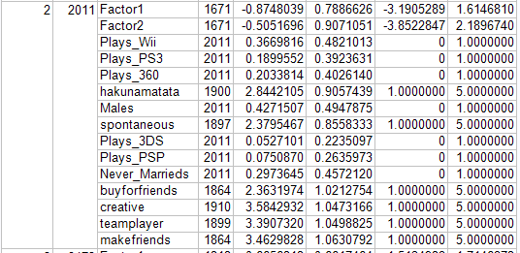
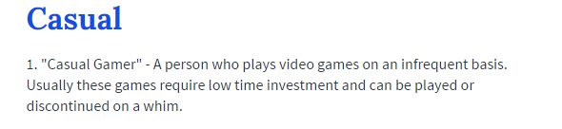
The Clusters – Cluster 2: The Casual Gamers
The people in this cluster are the healthiest individuals of all the clusters. They score the lowest on family, teamwork, spontaneity, creativity, and had the most difficulty making friends. This implies that residents of this cluster are probably fit and active with strict lifestyles and probably don’t play much video games as they scored the lowest in all of the console and handheld gaming devices. They’re probably professionals or maybe even students who only play occasionally – hence the name, Casual Gamers

Slide 28
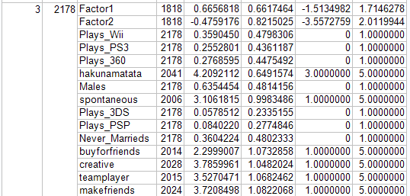

The Clusters – Cluster 3: The No-Lifers
These folks are the unhealthiest of all the clusters. They scored low on family, had the most individuals that had never been married, the most males, and the most carefree. They aren’t very spontaneous, find difficulty making friends, and they don’t like to work in teams. The No-Lifers probably don’t live a very active life style and indulge in junk/fast food, which probably influences the never married factor and lack of family time. Interestingly enough these people scored the highest on PS3 and Xbox 360 consoles. These consoles are superior in hardware and performance to the Wii which lacks the processing power necessary to play higher end games.

Slide 29
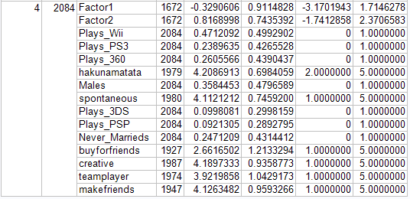
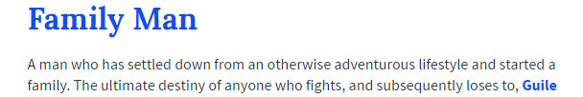
The Clusters – Cluster 4: The Family Gamers
The Family Gamers of course scored the highest on family, had the highest percent of married and female participants, and are relatively healthy individuals. Most likely settled and successful families, these people are quite carefree and spontaneous. They consider themselves to be creative, make friends the easiest, and prefer to work on teams the most. Scoring highest in Wii and handhelds, Mom and family man probably spend evenings at home with their kids playing games on the Wii or a nice vacation as the kids are enjoying themselves on their 3DS or PSP.

Slide 30
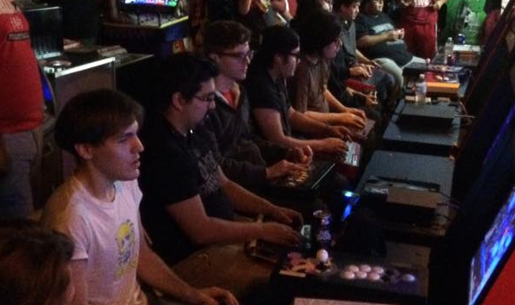



(1)
(2)
(4)
(3)

Slide 31
Final Thoughts
From your Hardcores to Casuals and No Lifers to Family Gamers there does seem to be some distinct differences amongst the modern gamers. Casuals and Families are more health conscious, while Hardcores and No Lives are not so inclined. Hardcores and Families prefer to work on teams and build relationships, while Casuals and No Lifers prefer to stick to themselves. Families and people that are more outgoing seem to like the Nintendo Wii more, while Hardcores and No Lifers seem to prefer the performance and power of the Xbox and PS3. Furthermore, while families do tend to purchase and play more handheld gaming devices than the other groups, it was noted that the Nintendo 3DS outscored the PSP in every cluster.

